Slide 1
Exploring the Existence of Dark Matter
Group 6
Benjamin, Brianna, Hien, Joselin, Sonia
Notes:
Joseline

Slide 2
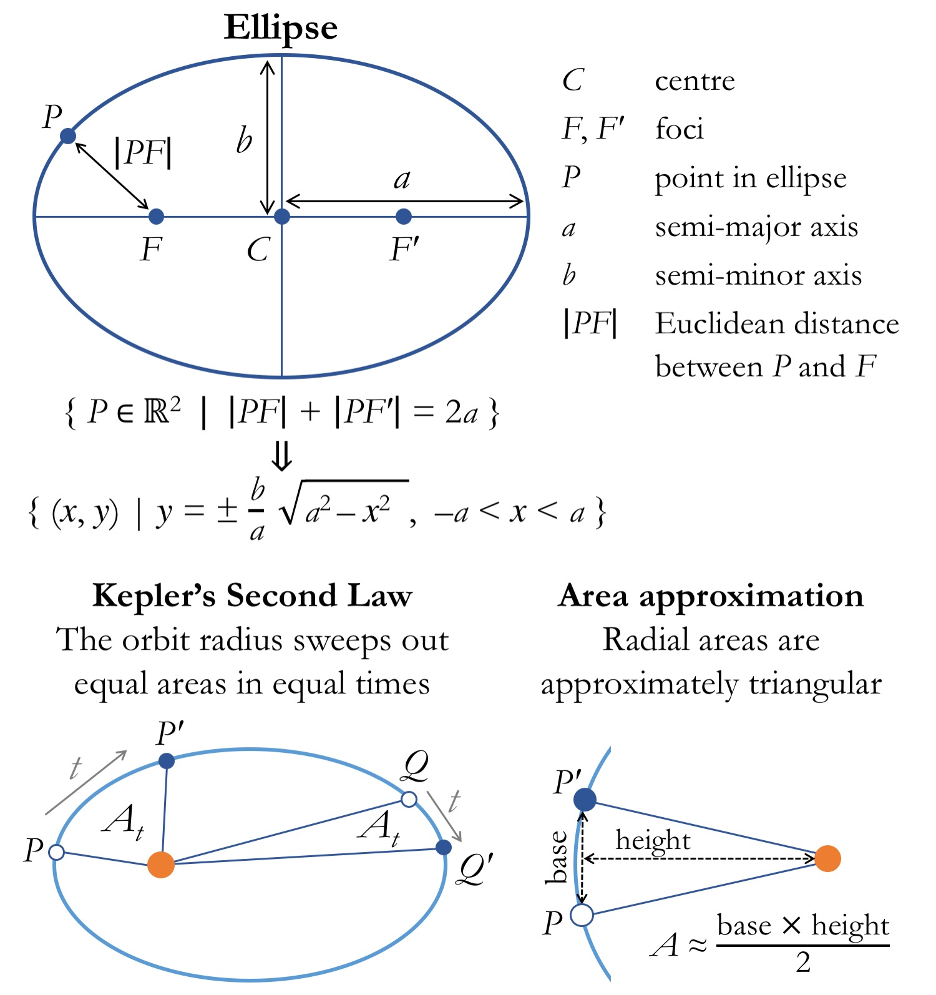
Kepler’s Law
Used to calculate and model orbits
Keplerian orbits: Elliptical paths of one body around another
Notes:
Benjamin
Reflecting the mass distribution of objects within a galaxy, we would expect the rotational velocity of objects farther from the galactic center to decrease. This can be theorized by applying Kepler’s second law, which states that the orbit of a planet will sweep equal areas over equal intervals of time — as such, objects closer to the star would travel more quickly than those farther away.

Slide 3
What is Dark Matter?
Dark matter is a hypothetical form of matter thought to account for approximately 85% of the matter in the universe.
Why it’s called dark matter?
- Strong force
- Electromagnetic force
- Weak force
- Gravitational force
Notes:
Joselin
Cloud of gas
Explanations from here: https://youtu.be/PHS241aGUHU
Dark matter only interact trough with gravitational force that’s why we cannot see it cause it doesn’t interact with electromagnetic (we see things through electromagnetic).
Gravitational force is the weakest force, but gravitational effects is noticeable because of the abundance of matter and dark matter
Dark matter is called "dark" because it does not appear to interact with the electromagnetic force, which means it does not absorb, reflect, or emit electromagnetic radiation and is, therefore, difficult to detect.
The primary evidence for dark matter comes from calculations showing that many galaxies would behave quite differently if they did not contain a large amount of unseen matter. Some galaxies would not have formed at all and others would not move as they currently do.

Slide 4
Methods/Equations
Python Libraries: pandas, matplotlib, astropy, numpy
Object - Oriented Programming
Simple animation, curve-fitting, data analysis
F = m.a
G.M(r)
r
v² =
Notes:
Brianna
Data analysis:
Matplotlib, pandas, astropy, numpy, lmfit
Simulation (code by James Sunseri):
-Simple unphysical simulation
-Object-oriented programming to create star class
-O(N^2) algorithm for gravity
-computation time ~ (amount of objects) squared

Slide 5
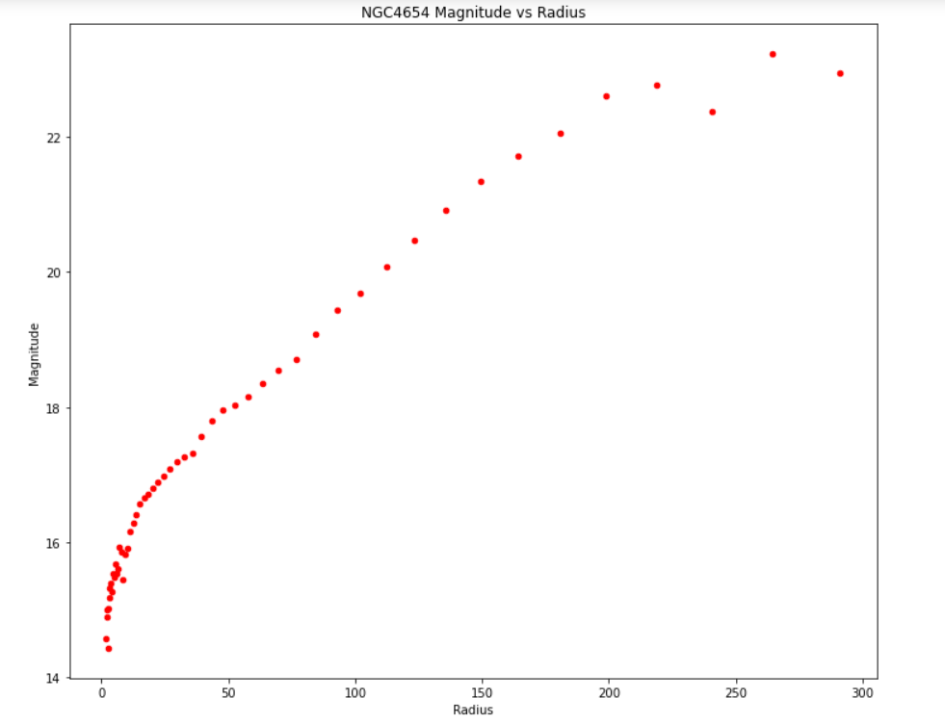
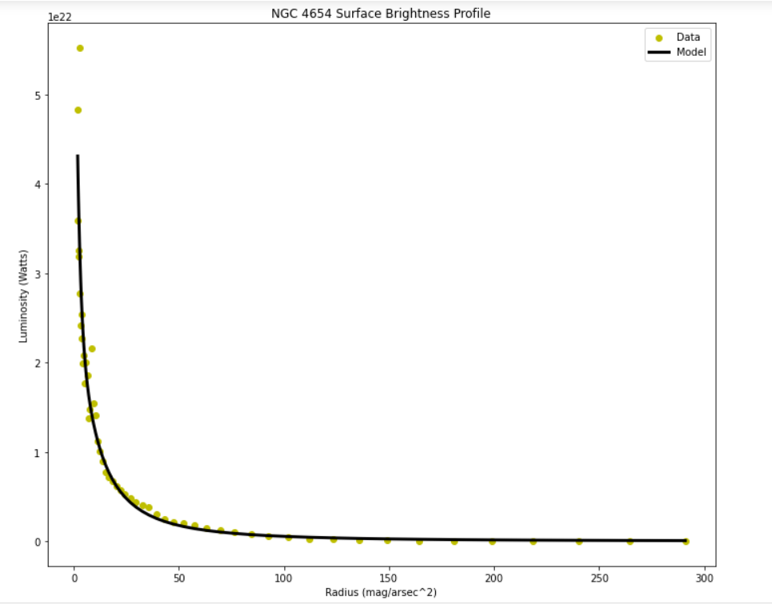
Surface Brightness Profile
M2 - M1 = 2.5 log (L1 / L2)
Notes:
Sonia
Here we have a magnitude against radius plot for stars in the NGC 4654 galaxy. Magnitude is how bright a star is. I’ve been told that astronomers use weird ways to measure things, which is why here, as the magnitude increases, it actually means that the brightness of the star decreases.
To make it easier to visualize, we can convert magnitude to luminosity by using this formula, which produces this plot. This is the surface brightness profile of the galaxy. Surface brightness profiles of spiral galaxies generally exhibit exponential decay because as the distance from the galactic centre increases, there are less stars in the outer rim.
Since mass and luminosity are proportional, the rotational velocity of the galaxy SHOULD also exhibit a decay behavior.

Slide 6
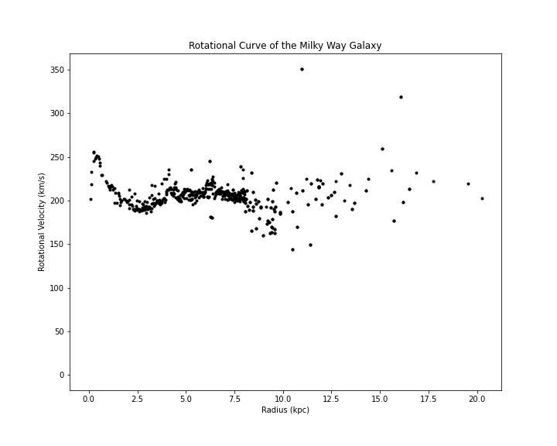
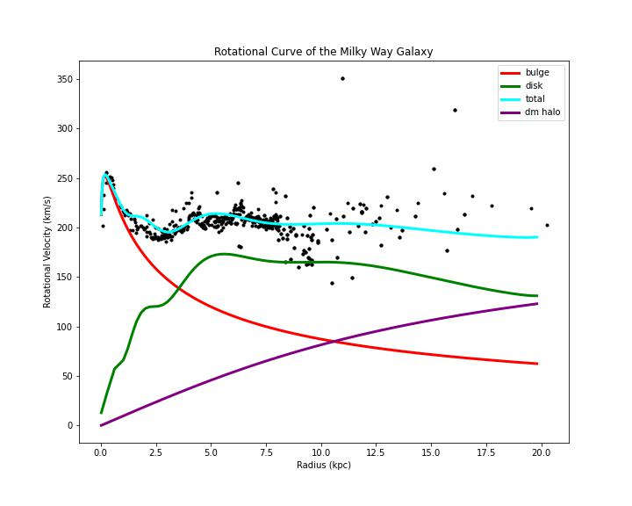
MW RC Data & Models
Rotational curve is “flat”
Non-luminous matter
Notes:
Hien
Rotational Curve data from University of Tokyo
Scatter plot:
- rotational velocity of the galaxy is constant w.r.t distance from galactic center
- (Go to velocity equation slide) that means mass is also increasing in order to keep the rotational curve constant
- from Luminosity plo for NGC 4654 → amount of luminous matter in the galaxy exponentially decreases with each radial shell
- that means whatever matter is present to keep rotational velocity constant has to be non-luminous
- influence of dm halo wins out over visible matter past 20 kpc ~ 65k Ly
- radius of Milky Way ~ 50k
Curves:
- Individual model velocity curves for bulge (stars), disk (most of the stars & dust), and dark matter halo all sum together to create a best fit for the data

Slide 7
Simulation of Hypothetical Galaxy without DM
 | 1
 | r
v² ∝
Notes:
Hien
In this simulation:
Set velocity to follow Keplerian behavior
Can see that “stars” closer to the central BH orbit at a velocity much faster than stars in the outer rim
Benjamin
The star density is highest at a radius a set distance from the center. The high rotational velocity of the center mass is so high that objects initially close to the center of the galaxy will begin to orbit rapidly and travel further from the center of mass.
The stars with elliptical orbits conserve angular momentum and as they slow when approaching the edges of the galaxy, their rotational velocity decreases.

Slide 8
Simulation of Hypothetical Galaxy with Dark Matter
Notes:
Hien
In this simulation provided by James:
- forced a constant rotational curve by using a gaussian function
- there is less of a difference between stellar velocity for each radial shell, unlike the last animation
The two animations are not physical (i.e. no real values or relationships were used), but can still see the difference in rotational curves.

Slide 9
References and Citation
NASA. (n.d.). Dark Energy, dark matter. NASA. Retrieved November 22, 2022, from https://science.nasa.gov/astrophysics/focus-areas/what-is-dark-energy/
SPARC. (n.d.). Photometric Profiles. SPARC. Retrieved November 29, 2022, from http://astroweb.cwru.edu/SPARC/
University of Tokyo. (n.d.). 2009: Tabular RC for the Milky Way Galaxy. University of Tokyo. Retrieved November 29, 2022, from http://www.ioa.s.u-tokyo.ac.jp/~sofue/h-rot.htm
Simple galaxy simulation code: https://github.com/James11222/Simple_Galaxy_Sim
Notes:
Brianna
Simple galaxy simulation code: https://github.com/James11222/Simple_Galaxy_Sim
NGC4654 Luminosity data:
http://astroweb.cwru.edu/SPARC/
Milky Way Rotational Curve data: http://www.ioa.s.u-tokyo.ac.jp/~sofue/h-rot.htm

